Slide 1

Unclaimed properties
Group 3
Team members
Jigyasa Nabh Haddyjatou Ndimbalan
Jonathan Gabriel Aaksha Sequeira
Akash Valathappan

Slide 2
What is Unclaimed Property?
Unclaimed property is a personal asset that has been separated from its original owner due to a variety of reasons. It has had no activity or contact with the original owner for more than a year due to the individual’s change of address or the fact it is there, is unknown to him/her.
If a business, government office, or any other source owes an individual or business money that they do not collect for a certain period due to relocation or absence of knowledge it is called Unclaimed property.
Notes:
There are different types of unclaimed properties but we are mainly focused on the unclaimed properties holders. We are focusing financial instition which are banks.

Slide 3
Why should we care about unclaimed property?
Most individuals in the public are not aware of what Unclaimed property is and that is one of the reasons there is an increase in the unclaimed property rate.
The government and the economy is losing out on taxable money.
Unclaimed properties are the liability for businesses which can cause auditing issues if it is not stated
Being aware of laws surrounding unclaimed property is essential for analysis because now we know that some unclaimed property law differs by state.
Millions of savings bonds now worth billions of dollars have stopped earning interest but have not been redeemed. It is easy to toss aside and forget about, or lose, paper savings bonds, especially if they were received as a gift as a child.
Notes:
Most individuals in the public are not aware of what Unclaimed property is and that is one of the reasons there is an increase in the unclaimed property rate. In the article “Why Unclaimed property risk management is on the menu in 2022” the author explains how It is especially important for people to understand how unclaimed property is and what are the laws centered around it. Some businesses do not even claim their properties because they want to avoid being taxed by the government. Unclaimed properties are the liability for businesses which can cause auditing issues if it is not stated. The state needs to create awareness about unclaimed property.
All 54 states in the United States have information on their website on how individuals and businesses can claim their Unclaimed property. Some websites like the National Association of State Treasurers help people find unclaimed property. Being aware of laws surrounding unclaimed property is essential for analysis because now we know that some unclaimed property law differs by state. Knowing the several types of Unclaimed properties will give us a brief understanding of the type of data we are dealing with. Reading the various articles we have better knowledge and understanding of how to approach our project.

Slide 4

Expected outcomes
Get insights about the number of unclaimed properties that are associated with each financial institute.
Identify which types of unclaimed properties are more important for financial institutions to focus on
Show visualization of the change in total unclaimed property amount throughout the years.
Notes:
From the datasets we gathered, it gives us insights about the property types that go unclaimed within financial institutions. Based on this data, we can identify which types of properties are more important for financial institutions and entities to audit on a timely basis. This analysis will be shown by visualizing the output data of the two merged datasets using any tool or application for visualization.

Slide 5
Data Discovery
The State of California
Downloaded data from California Unclaimed property website
Downloaded data were 3 csv files which were later merged
The State of Massachusetts
Used public record request to obtain the data
Received 2 txt files, out of which one was converted into csv file
Data Set | Source
California (3M rows) | Downloaded Unclaimed Property Records (ca.gov)
Massachusetts (1.7 M rows) | Public Records Request | Mass.gov
Notes:
We picked the top 5 banks from each data set

Slide 6
Our focus and goals
State of California
Banks Bank of America JP Morgan Chase Wells Fargo Bank of New York Mellon Corporate Trust
Unclaimed Properties Passbooks Mature Bond Principal Interest ( Bond Coupons) Principal Payments Paying Agent Account
State of Massachusetts
Banks Bank of America JP Morgan Chase Wells Fargo CITI Bank
Unclaimed Properties Mature CD or Save Cert Other Safekeeping Unidentified Deposit Checking Accounts
Identify top 4 banks from each states' dataset
Identify top 5 property types for each bank from each states' dataset.
Notes:
We picked the topic Unclaimed Property because it will a big business problem for financial and accounting institutes as they are the ones who deal with a huge volume of unclaimed property. Analysis of the information received from the states and answers derived from this project will be of use to financial institutions, like banks, holding enormous funds for individuals and businesses. This can be used to help them audit these funds and report them to the state complying with the State’s Unclaimed Property Law.

Slide 7
Data Wrangling Process
Data Discovery
Data formatting
Data profiling
Data Cleaning
Data Profiling
Data Analysis
Changed the names of columns such address, holder name, owner name, property ID, property type, remitted cash (changed to unclaimed money)
Data quality problems
Replace null values with "No Value" from names and addresses columns and merged the different columns
Identified 35 property types, 60K of reported unclaimed properties and $17M of total amount across unclaimed properties
Profile report 1
Generated report to find out if the data is clean to use for analysis
Mass public record database
Inserting the file into Python
Added all the
columns having unclaimed money
Bank of America reported highest amount of unclaimed money of $ 12M, Wells Fargo of $2M, Citibank and JP Morgan Chase with value less than $ 2M
Filter on the number of banks
Amount of data
Poor relevancy
Missing data
Inconsistent data
Little value added
Reduced the column range by filtering only the required columns
Checked for missing values in all the columns and city and zip had missing values
Changed the datatype in numeric columns from float to str in order to merge them together
Top 5 property types (MA) : checking accounts, savings accounts, cashier's checks, mature CDs and accounts receivables
Using the merged column for duplicates, we dropped duplicates using the drop function
For missing values, marked them as "No Value" since we cannot substitute values for unclaimed property data
Increased over the years with value touching $17M in 2021
Sorted based on property types
Replaced them with no city and no zip
California unclaimed property website
Inserting the file into Python
Profile Report 2
Removed all duplicate rows from dataset
Standardized the zip codes and property types
Stripped the white spaces from owner name and addresses

Slide 8
Data Formatting
Changed the names of each columns because it was difficult to identify e.g address, holder name owner name, property ID, property type, remitted cash
Filtered out the banks from Holder names of each dataset based on business context
We changed the datatype in numeric columns from float to str in order to merge them together
Sorted dataset based on property ID depending on business context

Slide 9
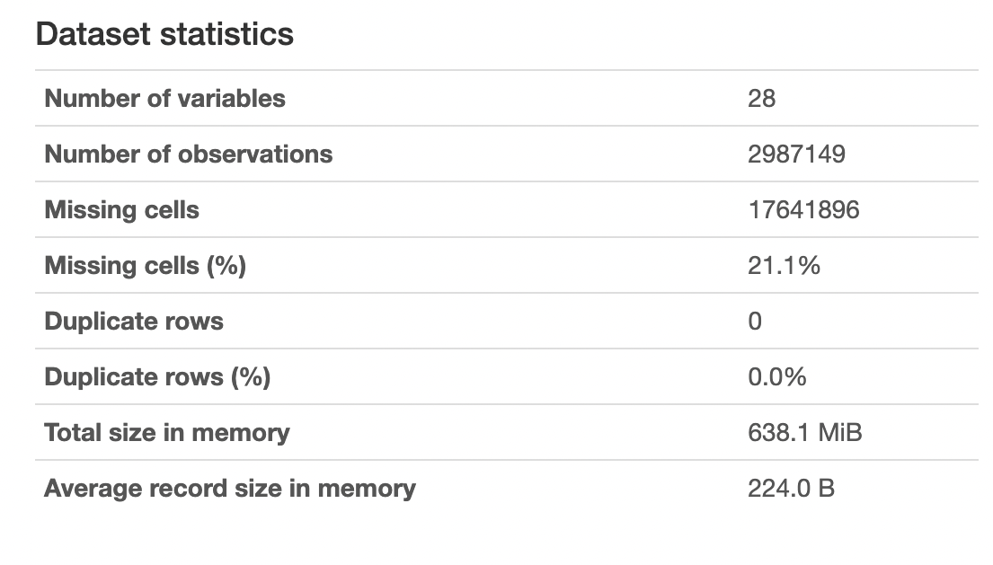
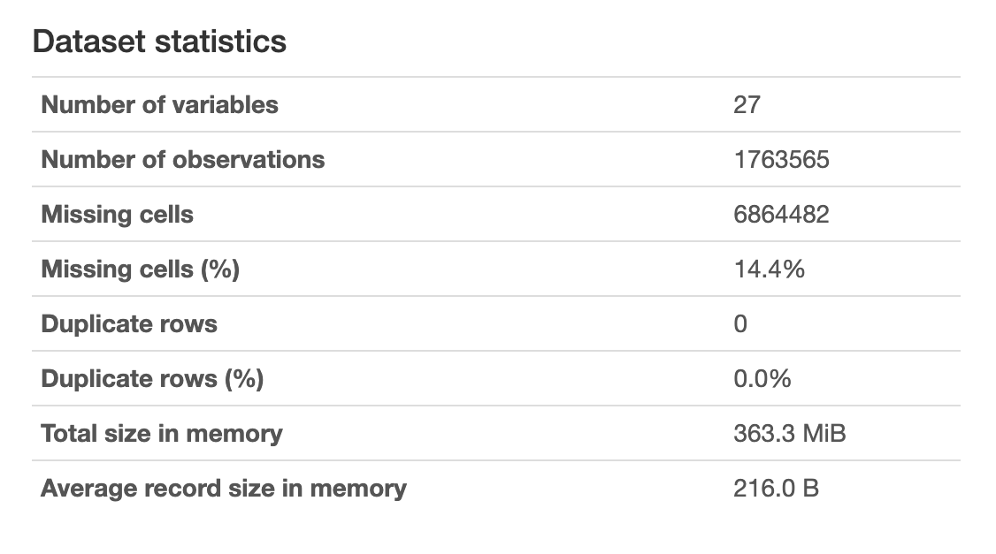
Data profiling before Preprocessing
CA Dataset:
MA Dataset:

Slide 10
Data Cleaning
Using the merged column for duplicates, we dropped duplicates using the drop duplicates function
We stripped the white spaces from owner name and addresses

Slide 11
How we handled challenges
Challenges
Techniques Followed
Zipcode in the following format:
01225
01225 – 4256
- 01225
01225 – 0000
01225 -00000
Zip codes have more than or less than numbers 5
Methods & Techniques
Followed for Challenges faced
Used the following solution
1. Str Split (" - "), grab first string
2. Str Slice (stop=5)
Missing owner names and addresses
Missing owner names and addresses
Used the following solution
Used fillna function to replace null values with "No Value"
Inconsistent data:
BANK OF AMERICA - NORTH CAROLINA, BANK OF AMERICA-MASSACHUSETTS, BANK OF AMERICA CORPORATION, BANK OF AMERICA – FLORIDA, BANK OF AMERICA – TEXAS. BANK OF AMERICA - PRE PAID CARD, BANK OF AMERICA - HOME LOANS, Bank of America N.A. F/K/A FIA Card Services NA
Inconsistent names for holder name
Used the following solution
Chose holder name with a part of string that contains Bank of America and changed it to Bank of America. Likewise for other banks.

Slide 12
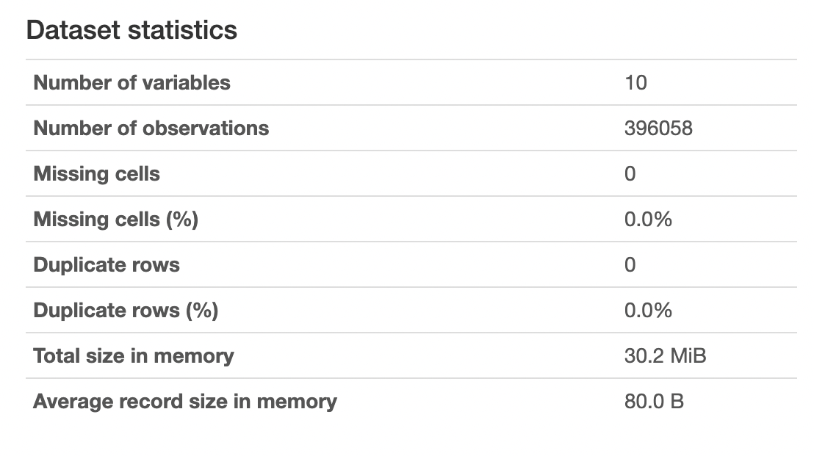
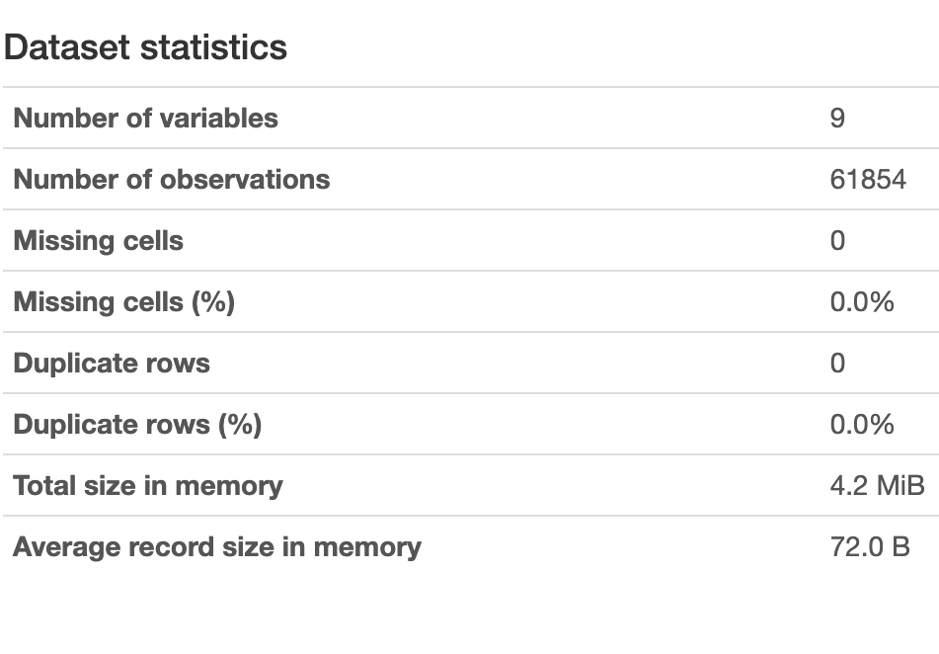
Data Profiling After Preprocessing
Total Observation for CA was brought down from 2.9 million to 396K observations.
Total Observation for MA was brought down from 1.7 million to 61K observations.
Formatted the columns from both the datasets and reduced it to 9 columns.
CA Dataset:
MA Dataset:

Slide 13
Data Quality
Huge amount of Input data (1.7 M
rows for MA , 2.9 M for CA)
Root condition: Computerizing
and data analyzing
Amount of data
Poor relevancy
Missing values
Inconsistent data
Duplicate records
Duplicate records existed in MA dataset after creating subset with required columns.
Root condition: Distributed computing
Data Quality
Some columns were irrelevant / unwanted.
Root condition: Changing data consumer's needs
Inconsistent bank
names and zip codes
Root condition: Distributed computing
14% of MA and 21% of CA datasets have missing values.
Root condition: Operational data production problems

Slide 14
Data validation rules
Precheck Zip code -
Business validation rule
The data collector must precheck the number of zip codes and if it is invalid or not when collecting data.
This solves the of inconsistent data in the dataset
Data Type Check -
System validation check.
The Unclaimed Money must be a number with the data type set as float.
This solves the of inconsistent data in the dataset
Subset creation:
Business Validation rule
Subsetting required columns
This solves the problem of poor relevancy
Check owner name and address:
The type of validation rule to check for missing values in owner name and addresses
System Validation rule
This solves the problem of incomplete data
Notes:
Precheck Zipcode - In the datasets there were issues with zipcode : some were invalid, and some had more and less than 5 numbers. We must set a business rule for the zipcode verification. The data collector must precheck the number of zipcode and if it is invalid or not when collecting data. This reduces the number of inconsistent data in the dataset.
Data Type Check - The Unclaimed Money must be a number with the data type set as float. This can be set as a system validation check. For example, when the amount under unclaimed money is being entered it cannot be ‘$400’ or ‘four hundred dollars’, it can just be 400 or 400.00. This check makes sure that we do not have inconsistencies within the amount entered under unclaimed money.
Subset creation: The type of validation rule for subset creation is Business. It is decided that the columns Property_ID, Property_Type, Year_Reported or Date_Reported, Owner_Name, Address, City, Zip, Holder_Name, Unclaimed_Money from the MA dataset were relevant for us. This solves the problem of poor relevancy and root condition changing data consumer’s needs.
Check owner name and address: The type of validation rule to check for missing values in owner name and addresses is a system check. Since the name and address field cannot be blank the Null/NAN values need to be masked. This solves the problem of incomplete data and root condition is operational data production problems.

Slide 15
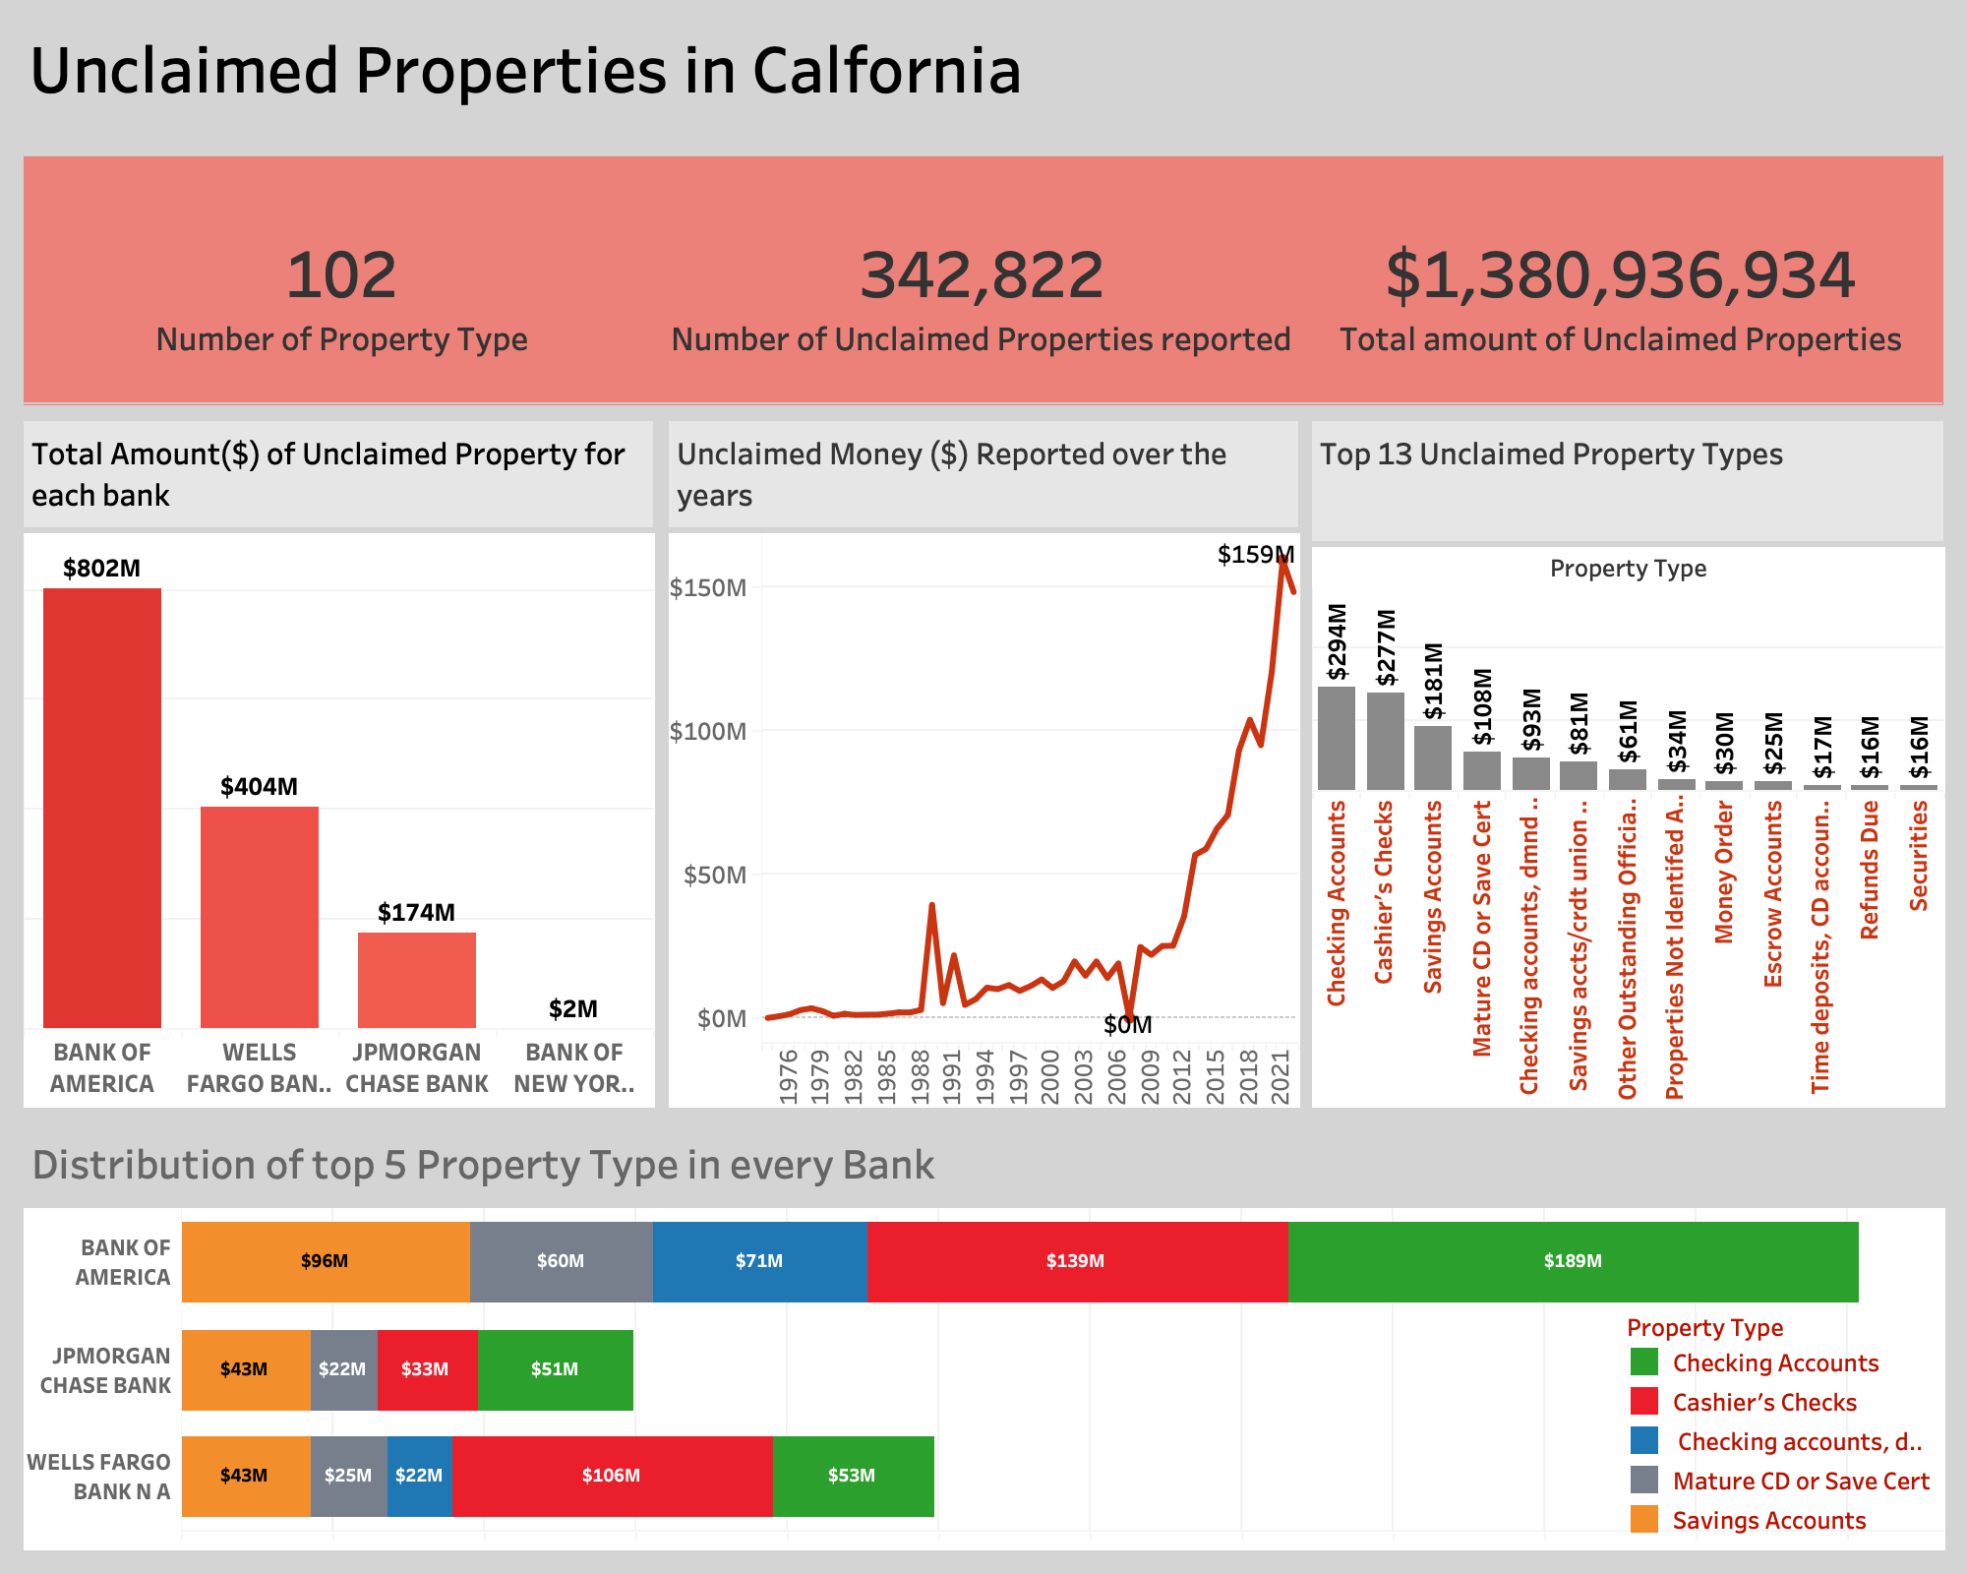
Data Analysis: Based on business context
Bank of America has the most amount of unclaimed money
The total amount of unclaimed property keeps increasing through out the years.
Checking account is the largest unclaimed property type
Dashboard contains:
Reported Unclaimed money over the years
Property types across banks
Property types over the years

Slide 16
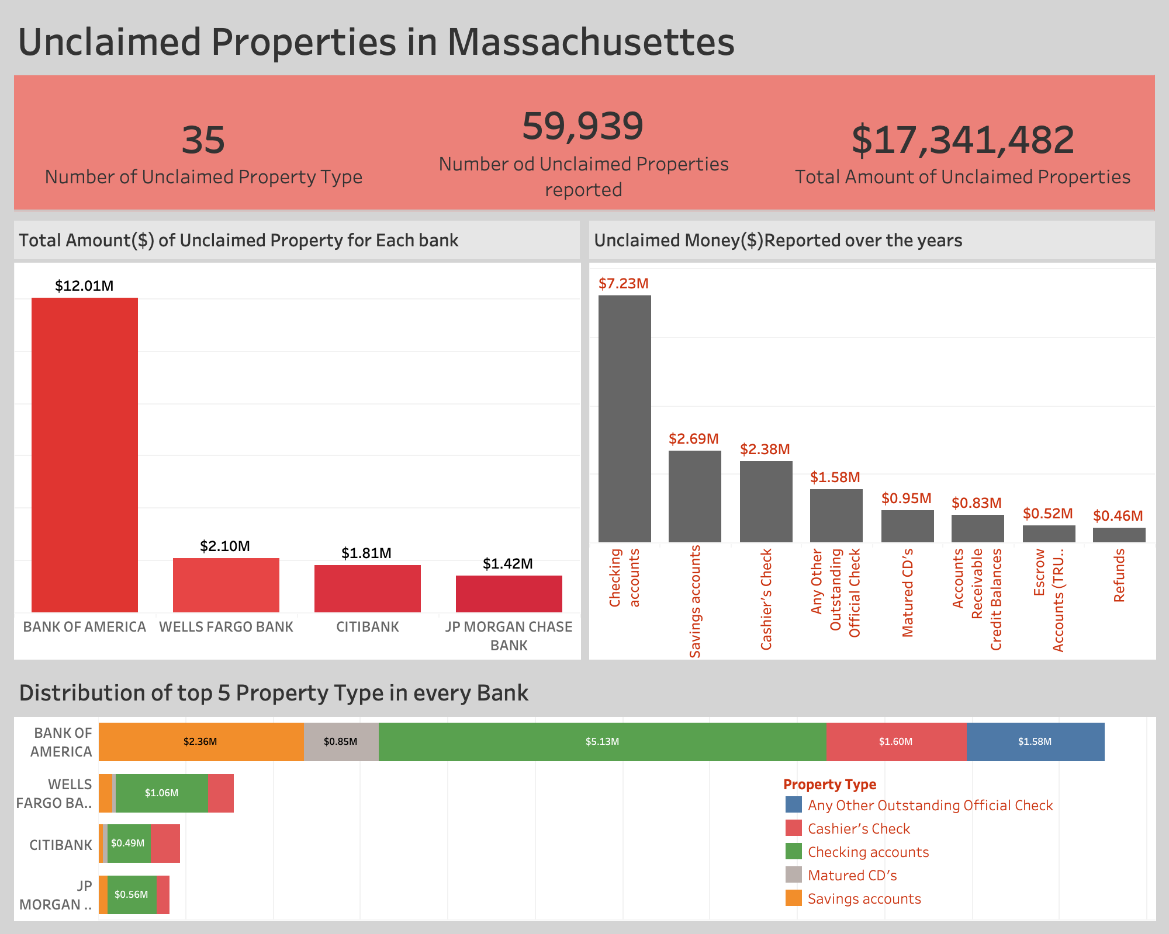
Data Analysis: Based on business context
Bank of America has the most amount of unclaimed money
Checking account is the largest unclaimed property type
Banks should focus on keeping track of addresses of customers with saving accounts and checking accounts
Dashboard contains:
Number of unclaimed properties
Ranking by banks
Top property types
Unclaimed money amount reported over the years

Slide 17
What we could have added or done
Looked at other unclaimed property holders like insurance companies and see number of property types they have
Enrich the datasets by adding another dataset that contains address of holders

Slide 18
THANK YOU!

